Slide 1
jQuery Plugins
Juan Dela Cruz

Slide 2
Topics
What is jQuery?
What are jQuery Plugins?
What are the pros and cons for using jQuery Plugins?
How can I implement jQuery Plugins?
What other useful and fun jQuery Plugins can we use?

Slide 3
The jQuery Library
Front-end JavaScript library. Not a framework.
“code less do more”
jQuery Core, jQuery UI and jQuery Mobile
How to use (in general):
1) Import it into your HTML file using script tags e.g:
2) Type in your jQuery code

Slide 4
jQuery Hello World

Slide 5
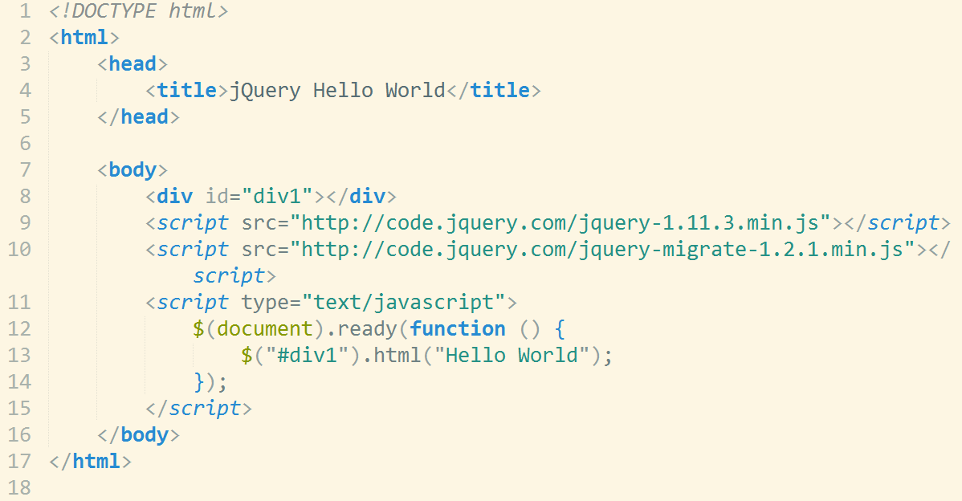

Slide 6
Using jQuery Plugins
Made by other developers
Instead of writing many of lines of code to implement a feature, you just need a couple of lines to import a plugin.
Detailed instructions available on the plugin’s website
Saves even more time and effort!

Slide 7
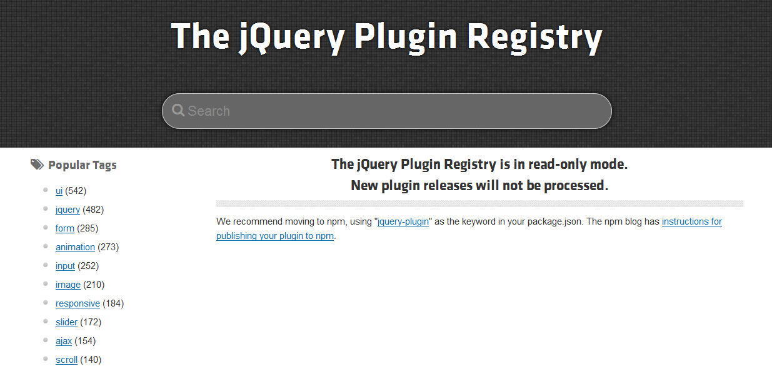
Where to find jQuery Plugins
Repositories:
plugins.jquery.com
myjqueryplugins.com
jquer.in
Unheap.com
Search engines

Slide 8
Pros and Cons
Pros
You save time
You write less code
You can add more complex features
Easy to implement
Cons
Some plugins are incompatible to be used together
Too many plugins increase loading times
You need to check for updated versions of the plugin
Developers may stop updating their plugins
Needs JavaScript enabled

Slide 9
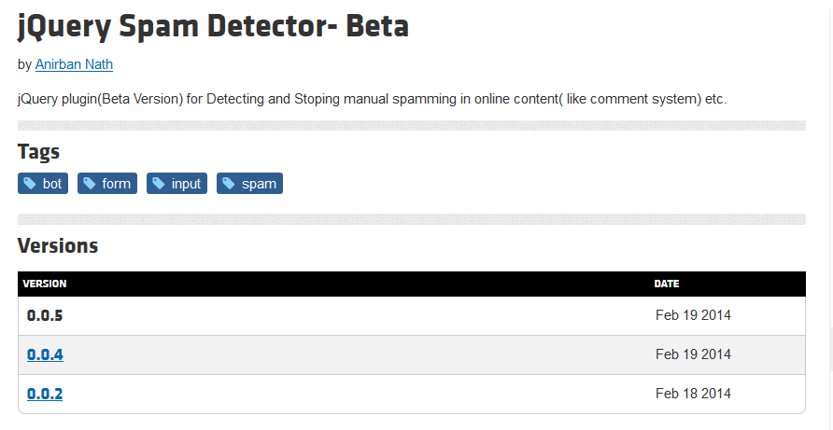
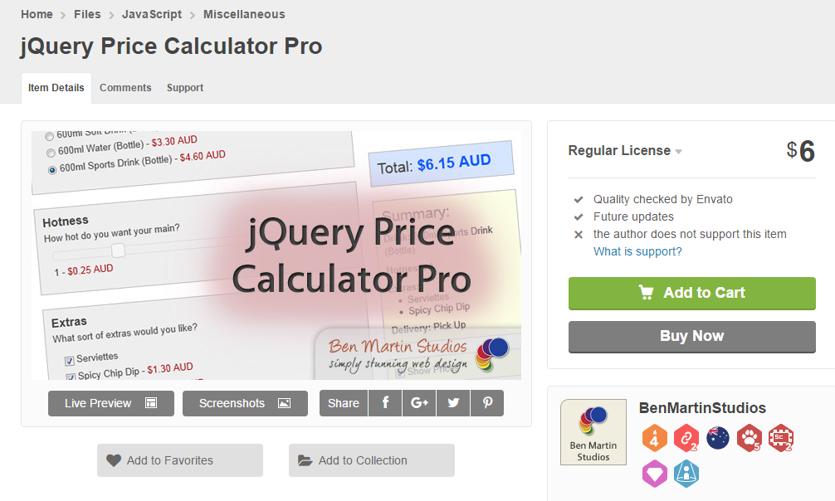
Other considerations
Some plugins are in beta
Not all plugins are free

Slide 10
Demo
How to implement some jQuery plugins

Slide 11

fakeLoader.js
Lightweight Animated Spinner

Slide 12
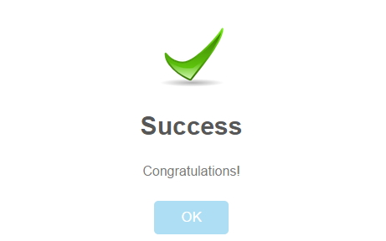
Sweet Alert
Stylish Alerts

Slide 13
Other Interesting jQuery Plugins

Slide 14
Other Interesting jQuery Plugins
Parallax.js (parallax scrolling effect) - http://pixelcog.github.io/parallax.js/
Raptorize (Raptor troll) - http://zurb.com/playground/jquery-raptorize
Elevator.js (scroll to the top) - http://tholman.com/elevator.js/

Slide 15
Other Interesting jQuery Plugins
UnicornBLAST (Unicorn awesomeness) - http://www.tehnrd.com/unicornblast/
Data-Driven Documents (manipulate document based on data) - http://d3js.org/
VideoJS (HTML video player) - http://videojs.com/

Slide 16
Thank You!

